Slide 1
Geometry with AR
Harsh Ved - hved095@rku.ac.in
Shrey Doshi - sdoshi983@rku.ac.in
Vinay Chauhan - vchauhan765@rku.ac.in
Vijay Odedara - vodedara272@rku.ac.in

Slide 2
Problem Statement
Three dimensional world is hard to visualize even for primary students.
For small children it becomes difficult to learn about shapes.
Because of the low imagination power, it is tough task to conceptualize 3D shapes form all the perspective.
Moreover, portrait solution or images are bound with some limitations.
Just by staring the images children can’t get complete idea from each and every angle.
As a consequences of which they get perplexed and bored.

Slide 3
Proposed Solution
These project is mainly for kindergarten students.
Using Augmented-Reality 3D geometric shapes will be spawned.
Gazing these augmented shapes small children will perfectly visualize the virtual objects present in their real world.
With the help of Mixed-Reality they will be able to play and interact with the shapes.
It will be rotatable, scalable and translatable.
Because of this interaction studying the shapes from all the perspective would be possible.
Brainstorming activities can be carried out by combining these virtual augmented shapes.

Slide 4


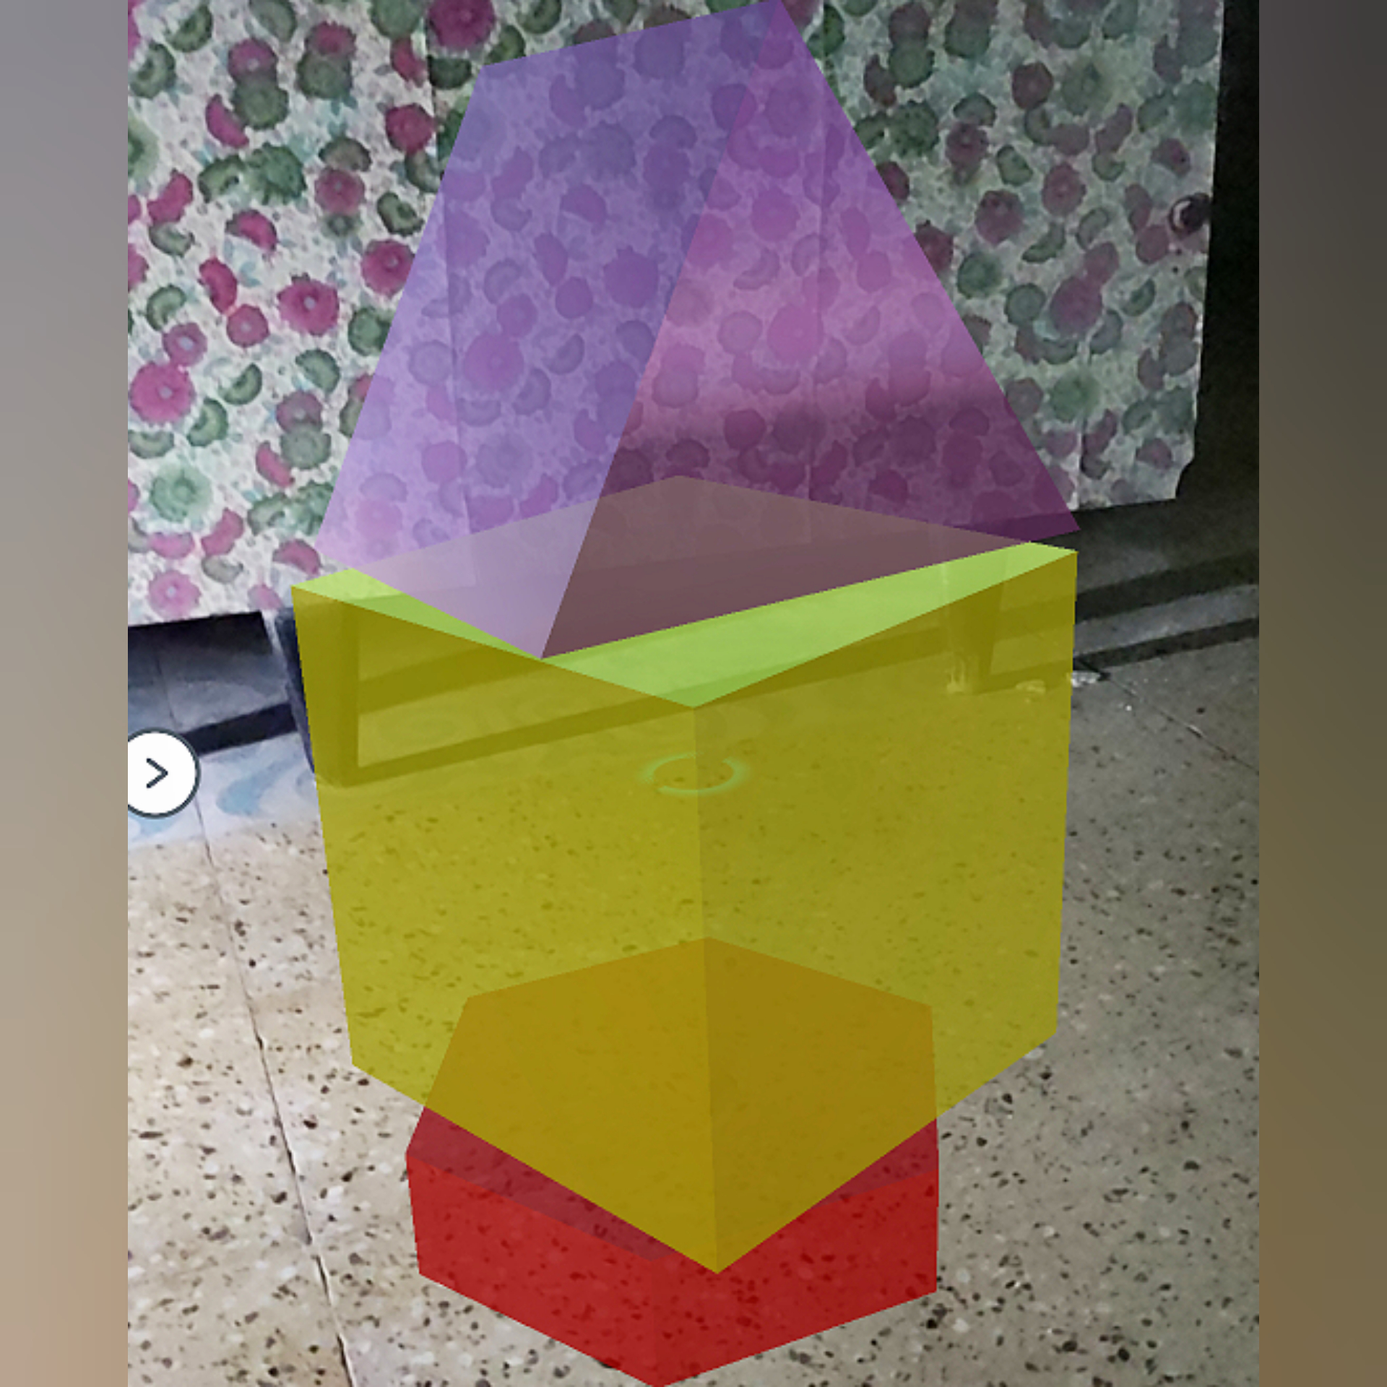
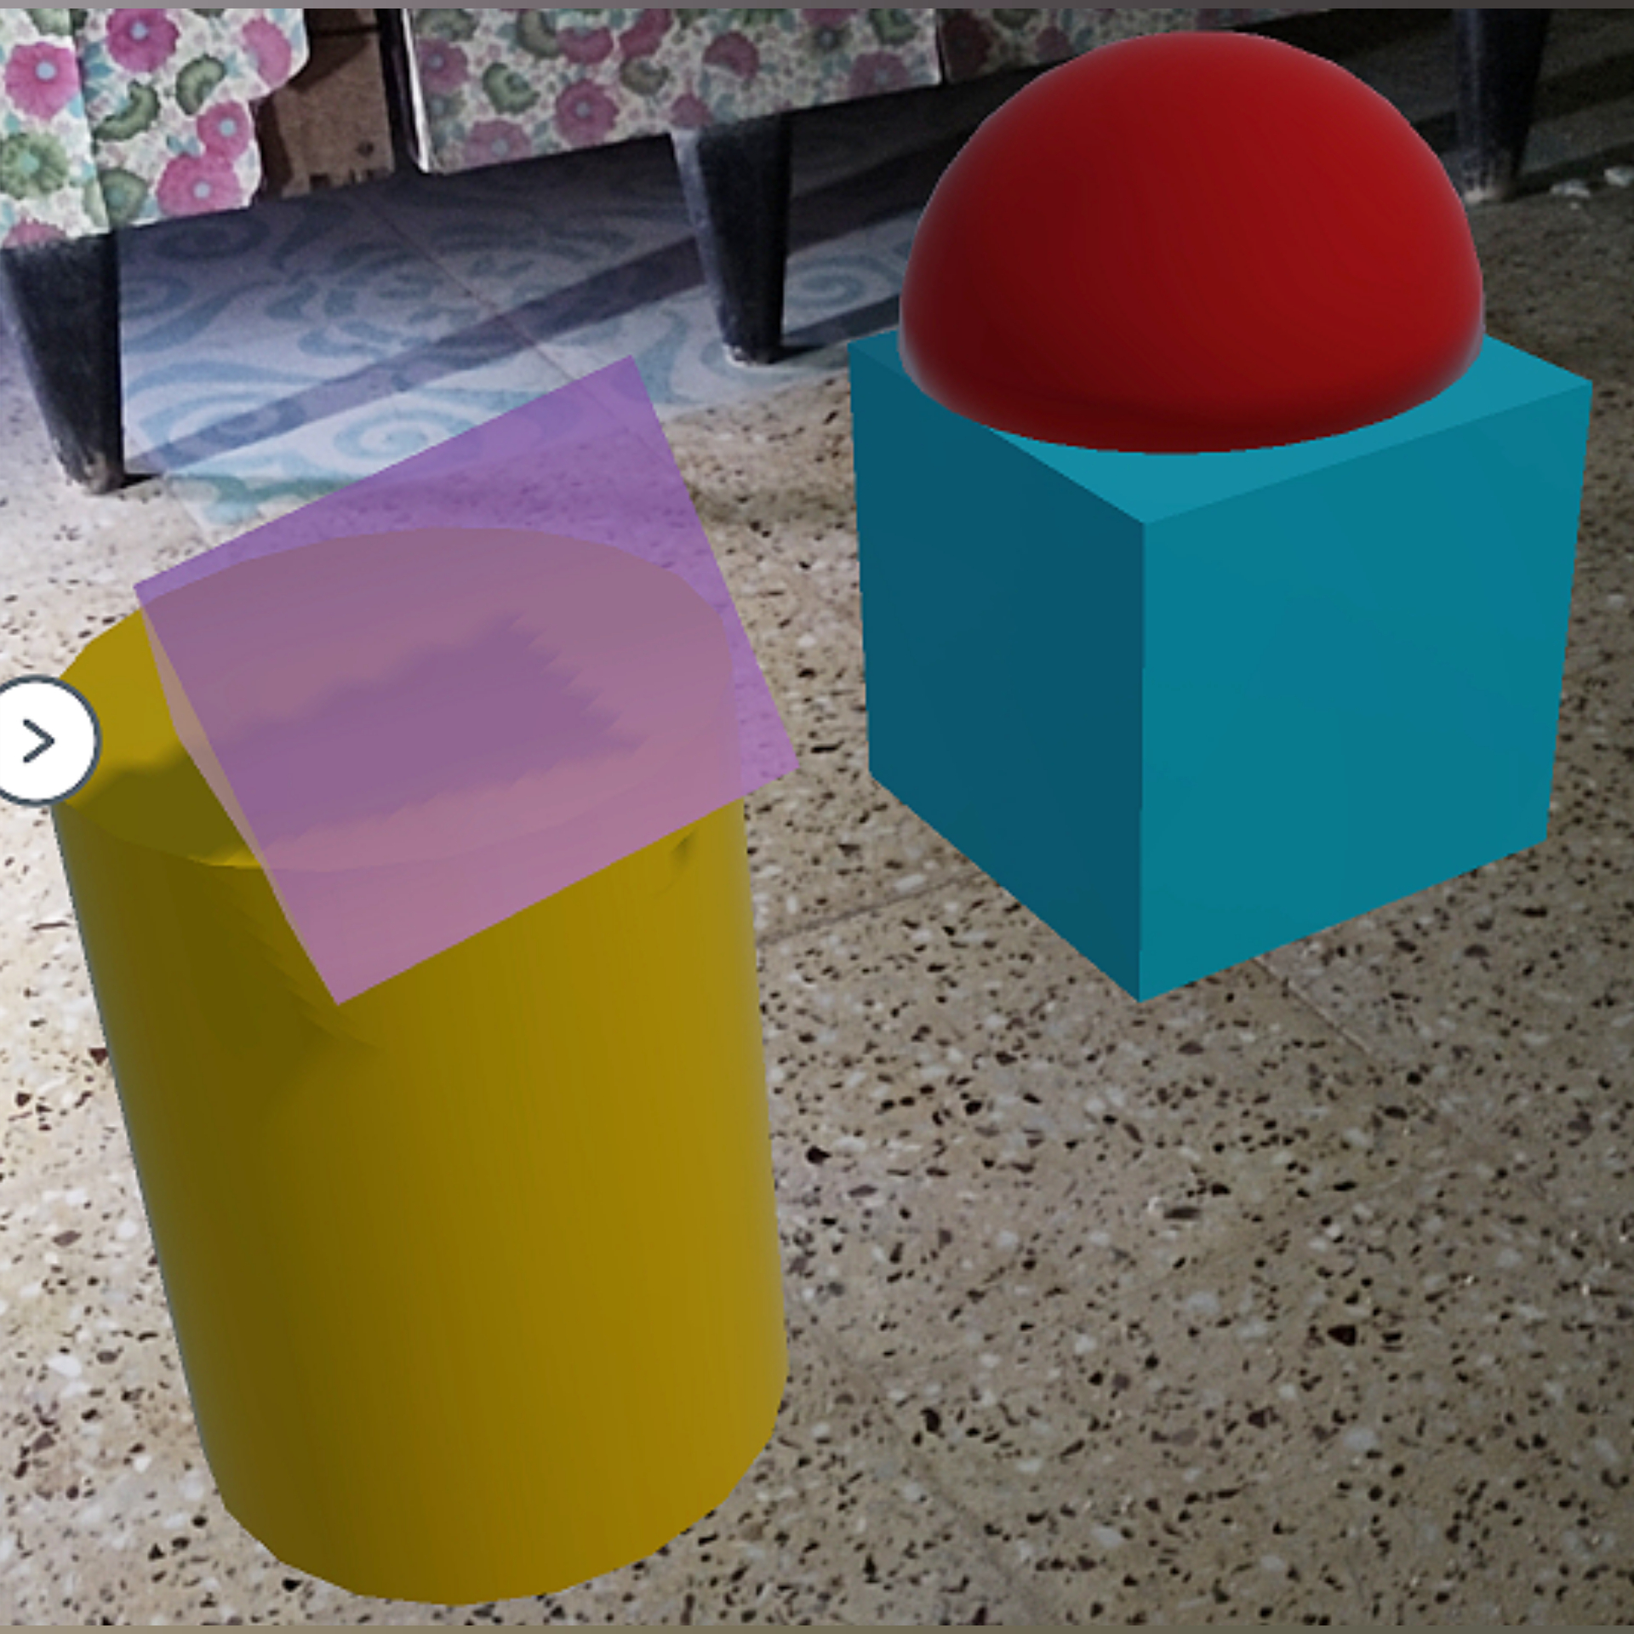
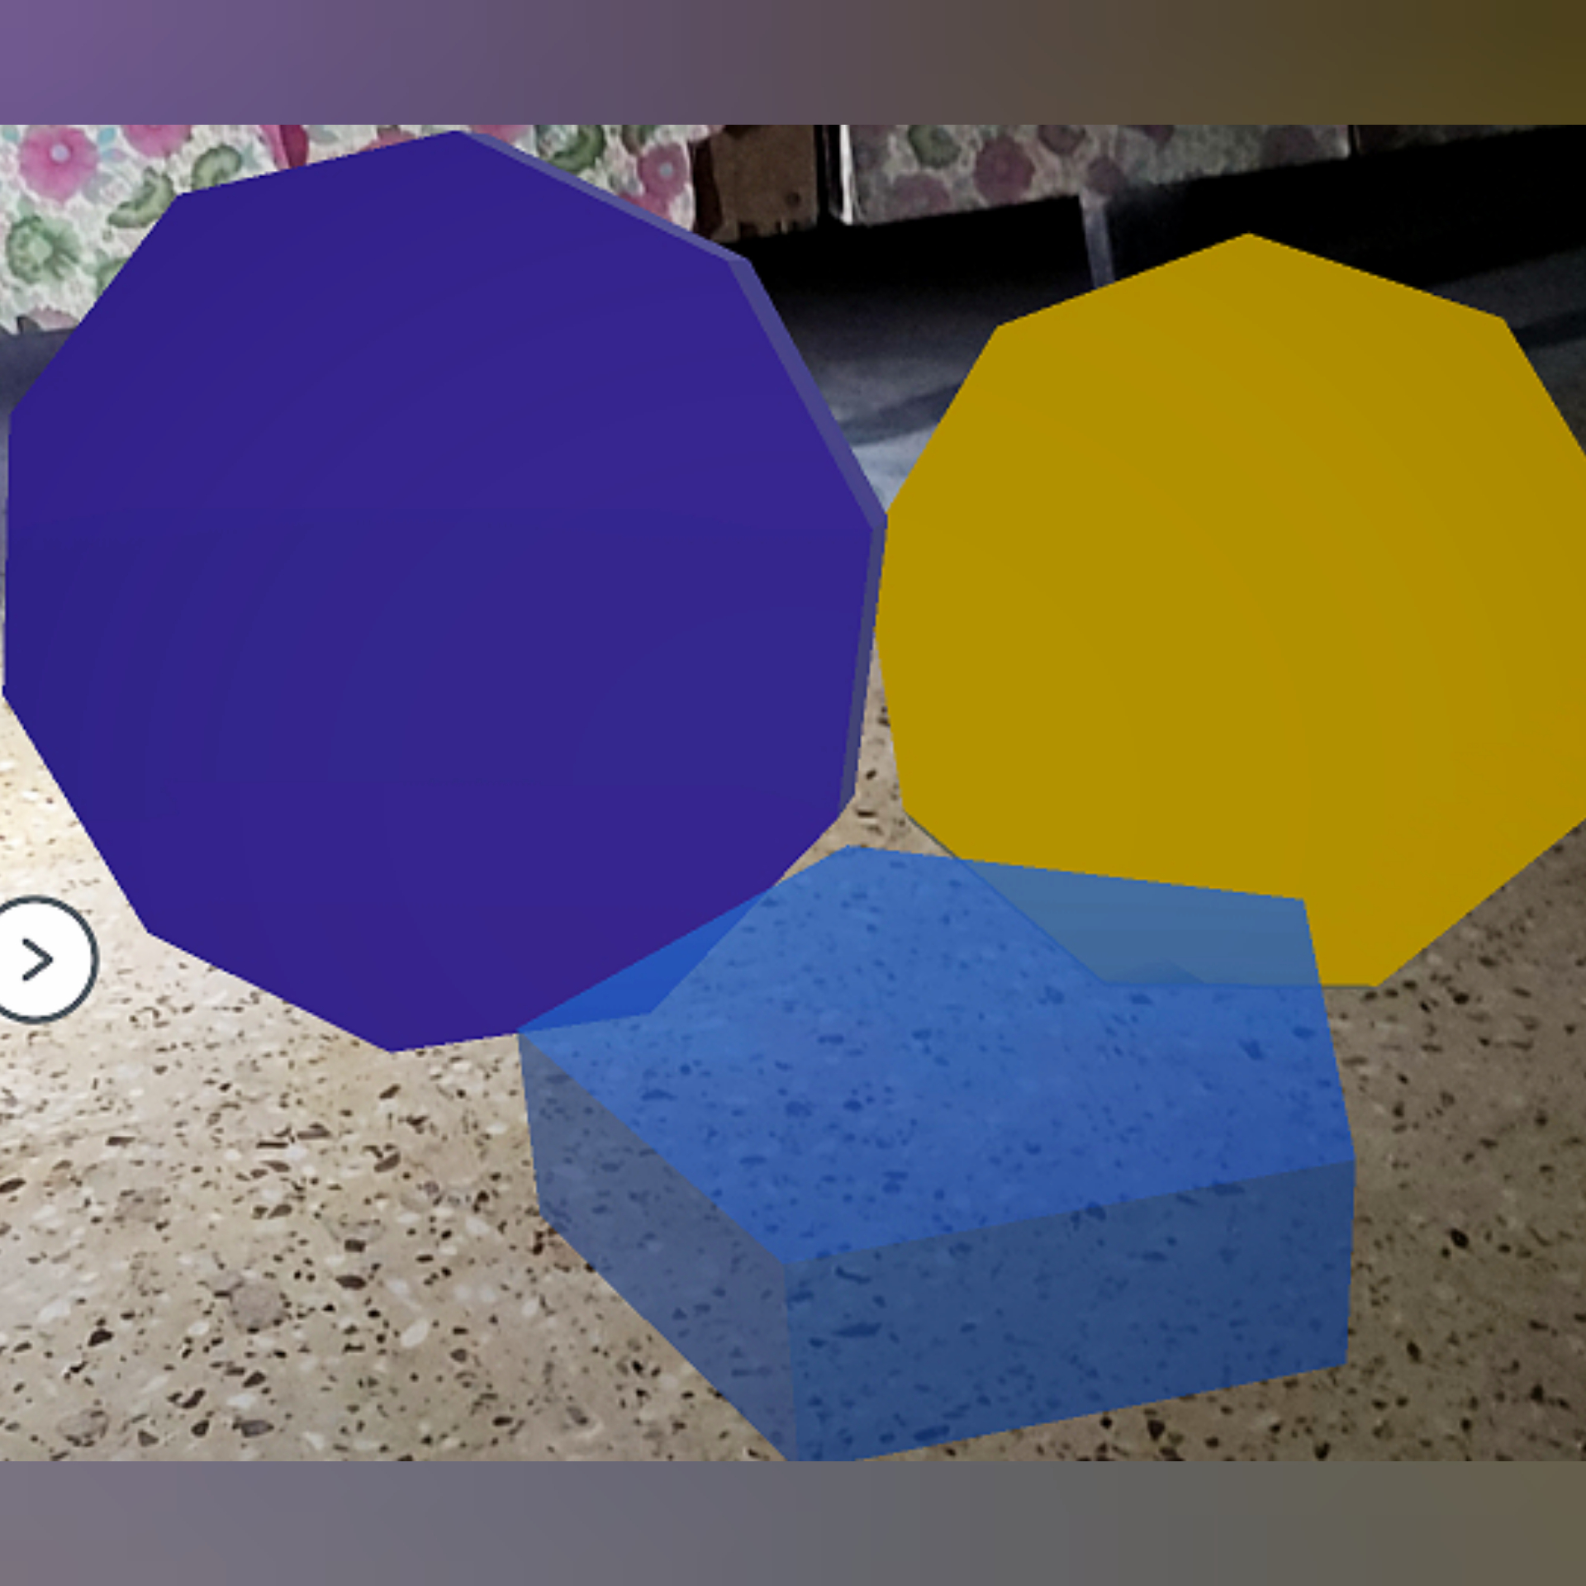

Glimpse of our work

Slide 5
Technology Used
Augmented Reality
Mixed Reality
AR Core
Unity Engine
C# programming

Slide 6
Required Tools
For developer :
Unity Engine
AR Core
Emulator or Mobile phone
For User :
Mobile with AR core supported

Slide 7
Target Market
Hence, audience like
Kindergarten Students
Primary Students
Teachers/Parents for teaching purpose.
Basic Learner who wants to learn about shapes.

Slide 8
Budget Summary
It is a software based project.
It is a mobile application.
Hence, It will be free of cost for all.

Slide 9
Thank You

